Slide 1


Slide 2

15
OLIGOPOLY
Notes:
Notes and teaching tips: 4, 9, 10, 11, 16, 18, 19, 20, 21, 22, 25, 53, 54, 69, 73, 80, 86, 88, 89, and 90.
To view a full-screen figure during a class, click the expand button.
To return to the previous slide, click the shrink button.
To advance to the next slide, click anywhere on the full screen figure.
Applying the principles of economics to interpret and understand the news is a major goal of the principles course. You can encourage your students in this activity by using the two features: Economics in the News and Economics in Action.
(1) Before each class, scan the news and select two or three headlines that are relevant to your session today. There is always something that works. Read the headline and ask for comments, interpretation, discussion. Pose questions arising from it that motivate today’s class. At the end of the class, return to the questions and answer them with the tools you’ve been explaining.
(2) Once or twice a semester, set an assignment, for credit, with the following instructions:
(a) Find a news article about an economic topic that you find interesting.
(b) Make a short bullet-list summary of the article.
(c) Write and illustrate with appropriate graphs an economic analysis of the key points in the article.
Use the Economics in the News features in your textbook as models.

Slide 3
After studying this chapter, you will be able to:
Define and identify oligopoly
Use game theory to explain how price and output are determined in oligopoly
Use game theory to explain other strategic decisions
Describe the antitrust laws that regulate oligopoly

Slide 4
What Is Oligopoly?
Oligopoly is a market structure in which
Natural or legal barriers prevent the entry of new firms.
A small number of firms compete.
Notes:
Understanding real world markets. Students have no difficulty seeing oligopoly in the world around them. Again, emphasize that the work they’ve just done understanding the models of perfect competition and monopoly are not wasted because the real-world situation of oligopoly can be better understood by building on some of the features of competition and monopoly. Again, some of what they learned in each of the two previous chapters survives and operates in oligopoly.
Traditional oligopoly models. Many instructors today want to skip the traditional models of oligopoly. Others want to teach only these models and skip the game theory approach. Your choice! This chapter is written in self-contained sections so that you can skip either approach.

Slide 5
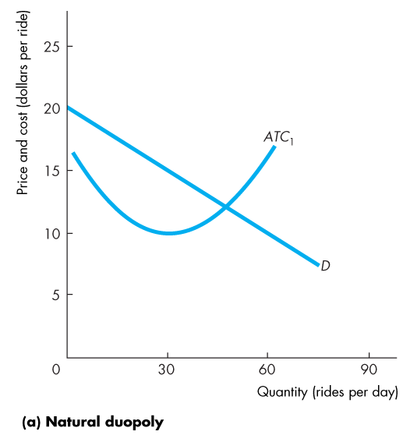
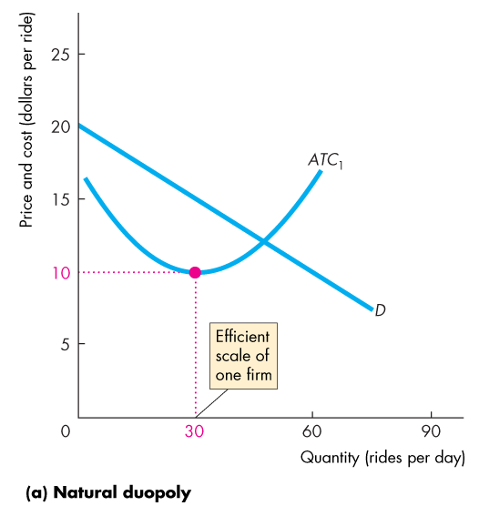
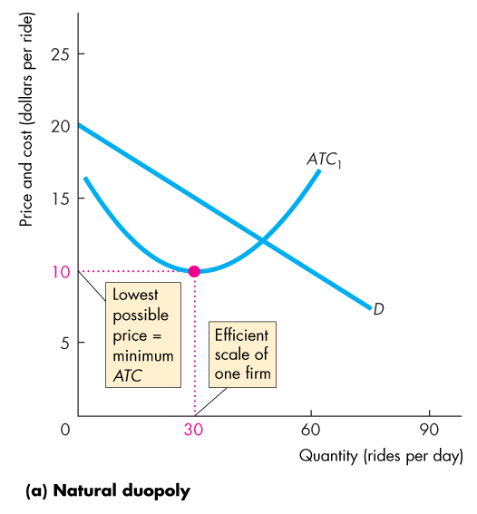
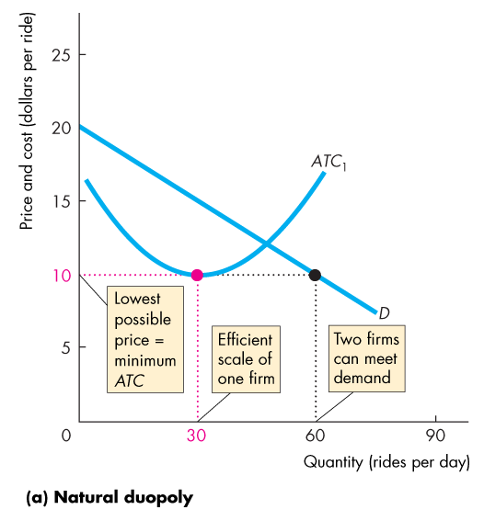

What Is Oligopoly?
Barriers to Entry
Either natural or legal barriers to entry can create oligopoly.
Figure 15.1 shows two oligopoly situations.
In part (a), there is a natural duopoly—a market with two firms.

Slide 7
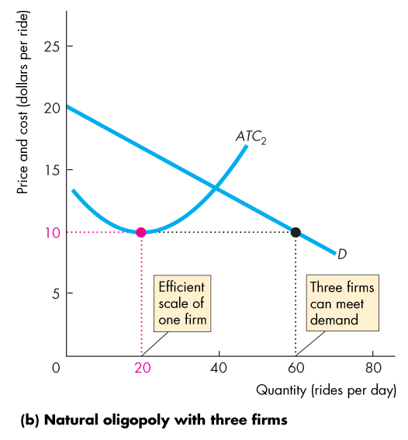
What Is Oligopoly?
In part (b), there is a natural oligopoly market with three firms.
A legal oligopoly might arise even where the demand and costs leave room for a larger number of firms.

Slide 9
What Is Oligopoly?
Small Number of Firms
Because an oligopoly market has only a few firms, they are interdependent and face a temptation to cooperate.
Interdependence: With a small number of firms, each firm’s profit depends on every firm’s actions.
Temptation to Cooperate: Firms in oligopoly face the temptation to form a cartel.
A cartel is a group of firms acting together to limit output, raise price, and increase profit. Cartels are illegal.
Notes:
Classroom activity
Check out Economics in Action: Oligopoly Today

Slide 10
Oligopoly Games
What Is a Game?
Game theory is a tool for studying strategic behavior, which is behavior that takes into account the expected behavior of others and the mutual recognition of interdependence.
All games have four common features:
Rules
Strategies
Payoffs
Outcome
Notes:
Game Theory
Game theory is an entirely different approach to modeling a firm’s output and price decisions. It allows for the expected actions of all other firms in the market to be explicitly considered in the firm’s decision-making process. Game theory is a big step for the student and needs a significant amount of time to develop. This chapter is designed to be flexible and provide you with many options on just how far to go.
1.You might want to introduce only the prisoner’s dilemma game. Pages 344–345 enable you to do that.
2.You might want to spend serious time applying the prisoner’s dilemma to a cartel game. Pages 346-350 enable you to do that.
3.You might want to extend the range of examples and apply the prisoner’s dilemma to a real-world research and development game. Page 351 enables you to do that.
4. You might want to extend to other games such as the game of chicken. Page 351 enables you to do that.
4.Finally, you might want to introduce repeated and sequential games and some of their applications and implications. Pages 352–355 enable you to do that.
6.Each of the steps laid out above is optional, but cumulative. You can stop at any point, but shouldn’t try to skip one step with the exception that you can teach the R&D game based on the general introduction to the prisoner’s dilemma without teaching the longer and more complex cartel game.

Slide 11
Oligopoly Games
The Prisoners’ Dilemma
In the prisoners’ dilemma game, two prisoners (Art and Bob) have been caught committing a petty crime.
Rules
The rules describe the setting of the game, the actions the players may take, and the consequences of those actions.
Each is held in a separate cell and cannot communicate with the other.
Notes:
The prisoners’ dilemma
Take things a step at a time and begin by playing the prisoner’s dilemma game. A good Web version of the game can be found on a site operated by a group called Serendip at Bryn Mawr College in Pennsylvania. The URL (also on your Economics Place Web site) is http://serendip.brynmawr.edu/playground/pd.html. If you can use the Web in your classroom, open two browsers and go to this site twice. Get two teams trying to beat Serendip.

Slide 12
Oligopoly Games
Each is told that both are suspected of committing a more serious crime.
If one of them confesses, he will get a 1-year sentence for cooperating while his accomplice will get a 10-year sentence for both crimes.
If both confess to the more serious crime, each receives a 3-year sentence for both crimes.
If neither confesses, each receives a 2-year sentence for the minor crime only.

Slide 13
Oligopoly Games
Strategies
Strategies are all the possible actions of each player.
Art and Bob each have two possible actions:
1. Confess to the larger crime.
2. Deny having committed the larger crime.

Slide 14
Oligopoly Games
With two players and two actions for each player, there are four possible outcomes:
1. Both confess.
2. Both deny.
3. Art confesses and Bob denies.
4. Bob confesses and Art denies.

Slide 15
Oligopoly Games
Payoffs
Each prisoner can work out what happens to him—can work out his payoff—in each of the four possible outcomes.
We can tabulate these outcomes in a payoff matrix.
A payoff matrix is a table that shows the payoffs for every possible action by each player for every possible action by the other player.
The next slide shows the payoff matrix for this prisoners’ dilemma game.

Slide 16
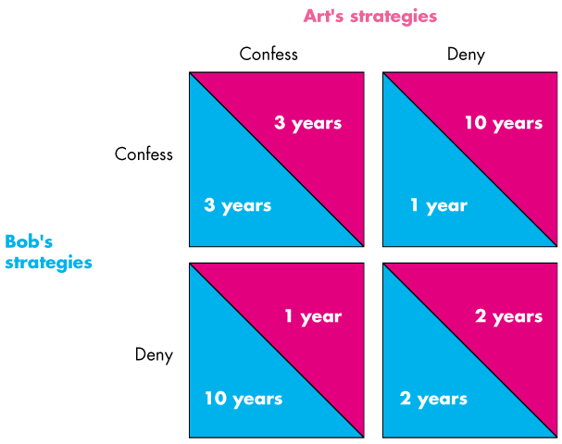
Oligopoly Games
Notes:
Be sure the students know how to read the payoff matrix.
Explain that Art’s payoff from each combination of actions is shown in the top of each payoff box, and Bob’s is shown as the bottom of each payoff box.
Note that there are four possible outcomes: Bob and Art both confess (top left box), both Bob and Art deny (bottom right box), Bob confesses but Art does not (top right box), and Art confesses but Bob does not (bottom left box).

Slide 17
Oligopoly Games
Outcome
If a player makes a rational choice in pursuit of his own best interest, he chooses the action that is best for him, given any action taken by the other player.
If both players are rational and choose their actions in this way, the outcome is an equilibrium called a Nash equilibrium—first proposed by John Nash.
Finding the Nash Equilibrium
The following slides show how to find the Nash equilibrium.

Slide 18
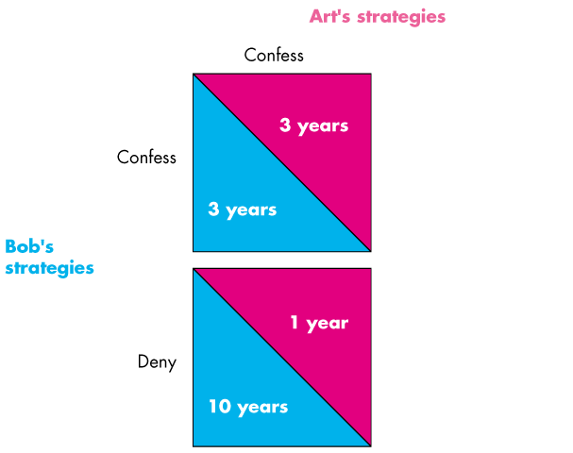
Oligopoly Games
Bob’s view of the world
Notes:
Explain that we’re first going to look at Bob’s thought experiment.
He first asks: suppose that Art confesses. What should I do?
The answer is confess and get 3 years. If I deny, I get 10 years.

Slide 19
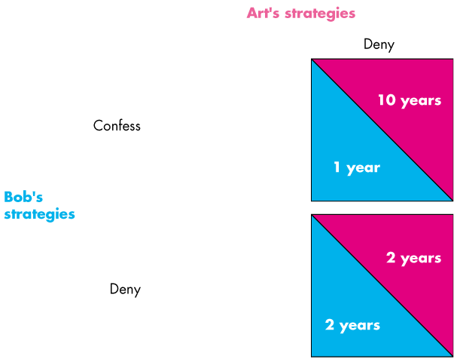
Oligopoly Games
Bob’s view of the world
Notes:
Explain that we’re first going to look at Bob’s thought experiment.
He first asks: suppose that Art confesses. What should I do?
The answer is confess and get 3 years. If I deny, I get 10 years.

Slide 20
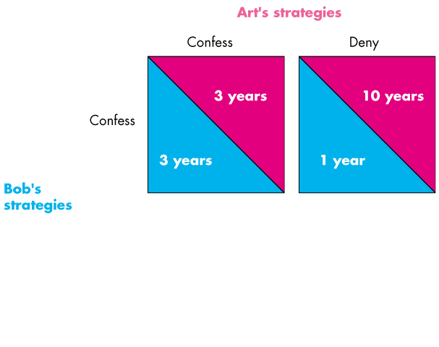
Oligopoly Games
Art’s view of the world
Notes:
Explain that we’re first going to look at Bob’s thought experiment.
He first asks: suppose that Art confesses. What should I do?
The answer is confess and get 3 years. If I deny, I get 10 years.

Slide 21
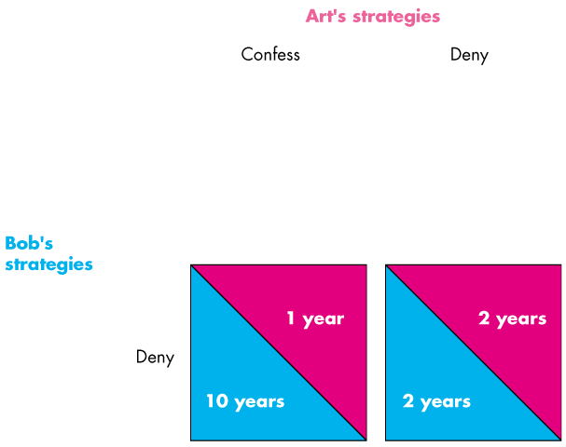
Oligopoly Games
Art’s view of the world
Notes:
Explain that we’re first going to look at Bob’s thought experiment.
He first asks: suppose that Art confesses. What should I do?
The answer is confess and get 3 years. If I deny, I get 10 years.

Slide 22
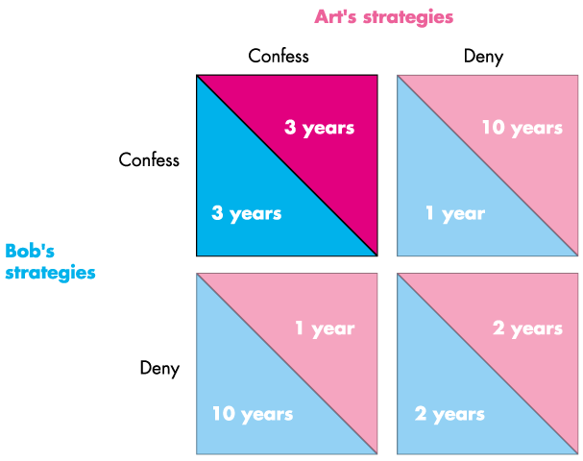
Oligopoly Games
Equilibrium
Notes:
Explain that we’re first going to look at Bob’s thought experiment.
He first asks: suppose that Art confesses. What should I do?
The answer is confess and get 3 years. If I deny, I get 10 years.

Slide 23
Oligopoly Games
The Dilemma
The dilemma arises as each prisoner contemplates the consequences of his decision and puts himself in the place of his accomplice.
Each knows that it would be best if both denied.
But each also knows that if he denies it is in the best interest of the other to confess.
The dilemma leads to the equilibrium of the game.

Slide 24
Oligopoly Games
A Bad Outcome
For the prisoners, the equilibrium of the game is not the best outcome.
If neither confesses, each gets a 2-year sentence.
Can this better outcome be achieved?
No, it can’t because each prisoner can figure out that there is a best strategy for each of them.
Each knows that it is not in his best interest to deny.

Slide 25
Oligopoly Games
An Oligopoly Price-Fixing Game
A game like the prisoners’ dilemma is played in duopoly.
A duopoly is a market in which there are only two producers that compete.
Duopoly captures the essence of oligopoly.
Cost and Demand Conditions
Figure 15.2 on the next slide describes the cost and demand situation in a natural duopoly in which two firms, Trick and Gear, compete.
Notes:
A Cartel Game. The prisoner’s dilemma to a cartel game on pages 348–354 has been carefully designed to get the maximum payoff from the knowledge your students have of the perfect competition and monopoly results of the two preceding chapters and to introduce them to game theory in a setting that is as close to the previously studied settings as possible.
1. The natural duopoly setting ensures that there is a zero profit equilibrium that corresponds to perfect competition and monopoly profit equilibrium.
2. Instead of just asserting a payoff matrix, the numbers in the matrix come directly from monopoly profit-maximizing and competitive outcomes. You need to do a bit of work (and so do your students) to generate the payoff numbers, but the whole story hangs together so much better when the student can see where the numbers come from and can see the connection between the oligopoly set up and those of competition and monopoly.
3. Start with Figure 15.2 (page 350) and after you’ve explained the cost and demand conditions shown in the figure, ask the students what they think the price and quantity will be in this industry. There will be differences of opinion. This diversity of opinion motivates the need for a model of the choices the firms make.
4. The game is set up so that the competitive equilibrium is the Nash equilibrium. You might want to emphasize that this outcome is efficient even though it is not the best joint outcome for the firms.

Slide 26
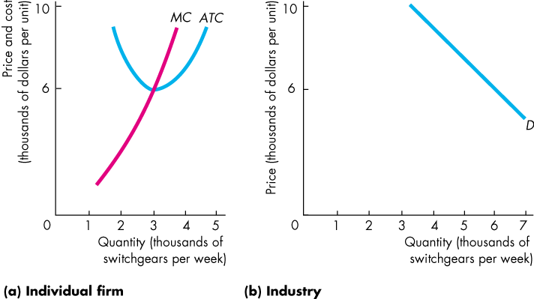
Oligopoly Games
Part (a) shows each firm’s cost curves.
Part (b) shows the market demand curve.

Slide 27
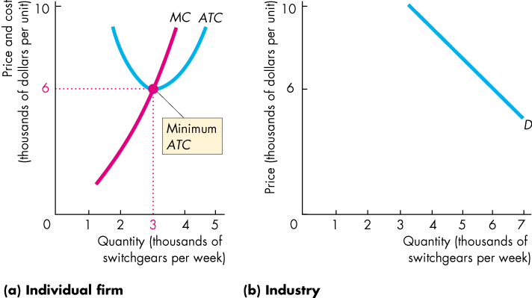
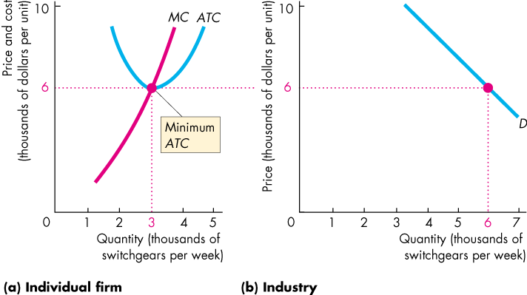

Slide 28
Oligopoly Games
This industry is a natural duopoly.
Two firms can meet the market demand at the least cost.

Slide 29
Oligopoly Games
How does this market work?
What is the price and quantity produced in equilibrium?

Slide 30
Oligopoly Games
Collusion
Suppose that the two firms enter into a collusive agreement.
A collusive agreement is an agreement between two (or more) firms to restrict output, raise the price, and increase profits.
Such agreements are illegal in the United States and are undertaken in secret.
Firms in a collusive agreement operate a cartel.

Slide 31
Oligopoly Games
The strategies that firms in a cartel can pursue are to
Comply
Cheat
Because each firm has two strategies, there are four possible combinations of actions for the firms:
1. Both comply.
2. Both cheat.
3. Trick complies and Gear cheats.
4. Gear complies and Trick cheats.

Slide 32
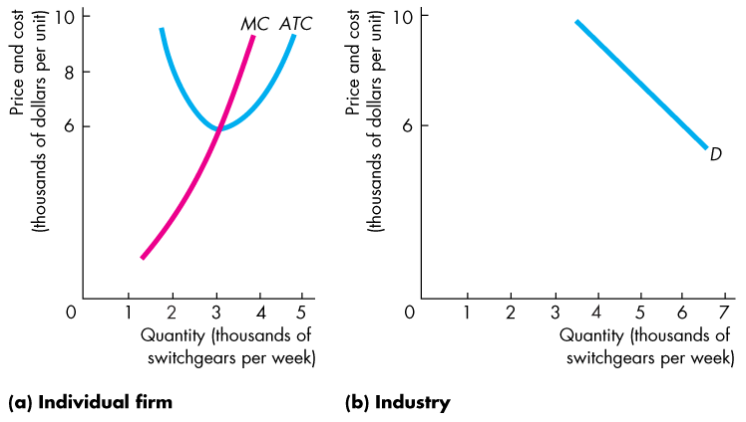
Oligopoly Games
Colluding to Maximize Profits
Firms in a cartel act like a monopoly and maximize economic profit.

Slide 33
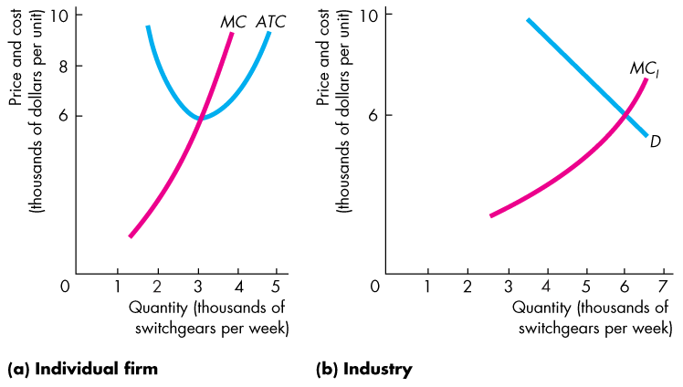
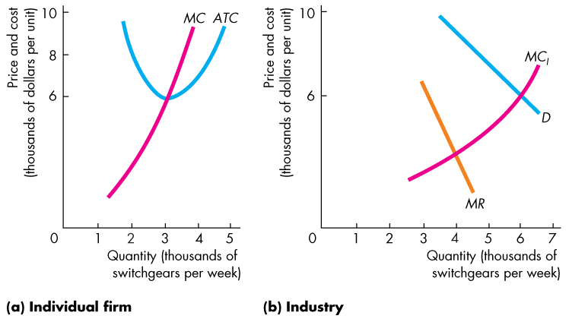
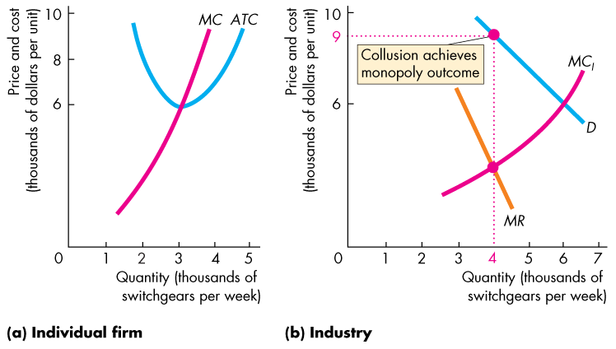

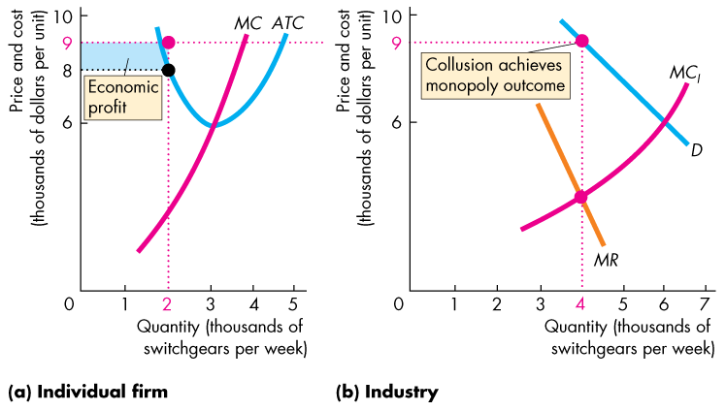

Slide 34
Oligopoly Games
To find that profit, set the cartel's marginal cost equal to its marginal revenue.

Slide 35
Oligopoly Games
The cartel’s marginal cost curve is the horizontal sum of the MC curves of the two firms.
The marginal revenue curve is like that of a monopoly.

Slide 36
Oligopoly Games
The firms maximize economic profit by producing the quantity at which MC_{I} = MR.

Slide 37
Oligopoly Games
Each firm agrees to produce 2,000 units and to share the economic profit.
The blue rectangle shows each firm’s economic profit.

Slide 38
Oligopoly Games
When each firm produces 2,000 units, the price is greater than the firm’s marginal cost, so if one firm increased output, its profit would increase.

Slide 39
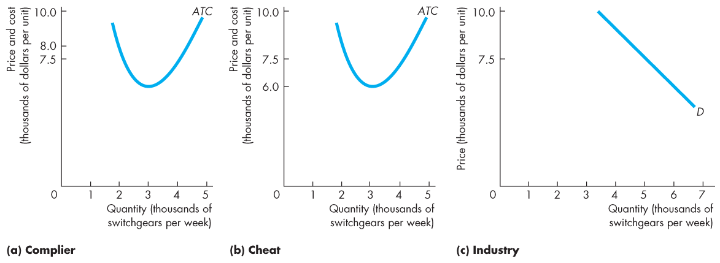
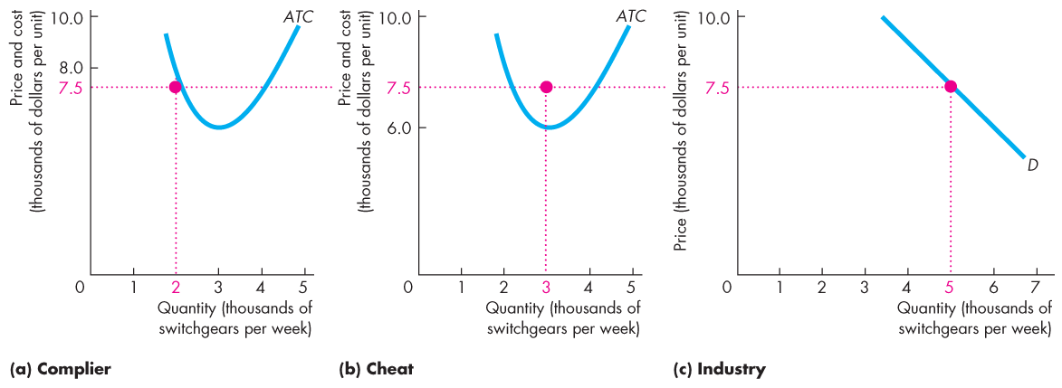
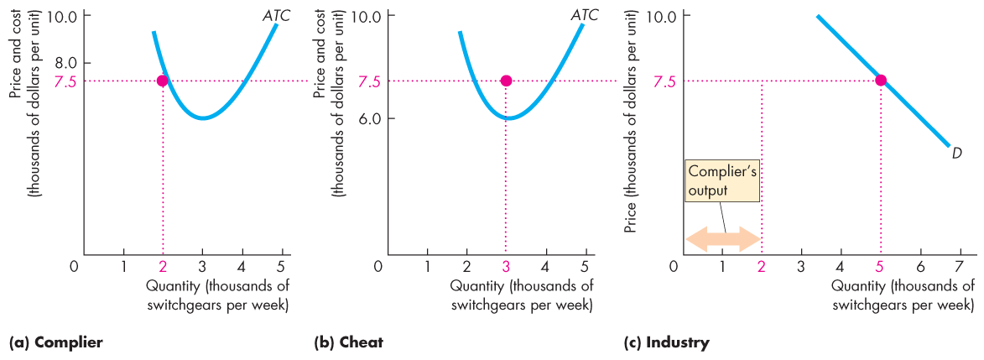
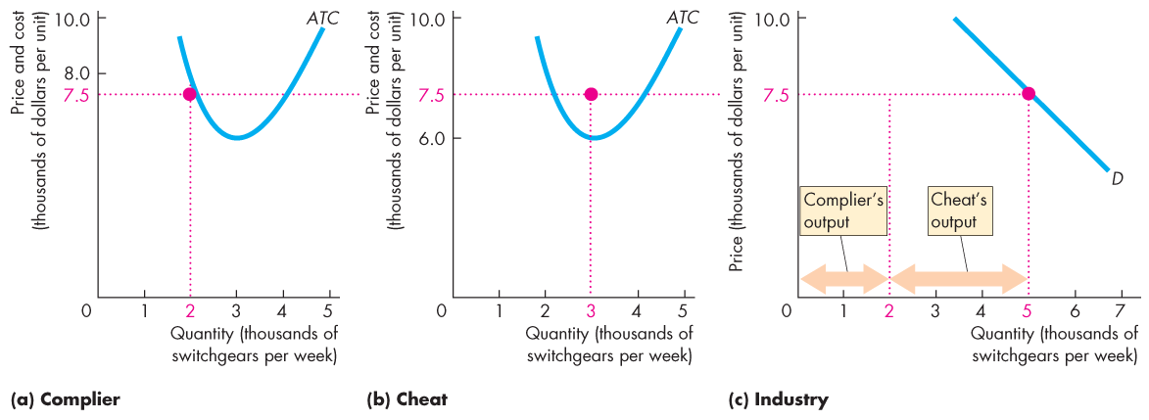
Oligopoly Games
One Firm Cheats on a Collusive Agreement
Suppose the cheat increases its output to 3,000 units. Industry output increases to 5,000 and the price falls.

Slide 40
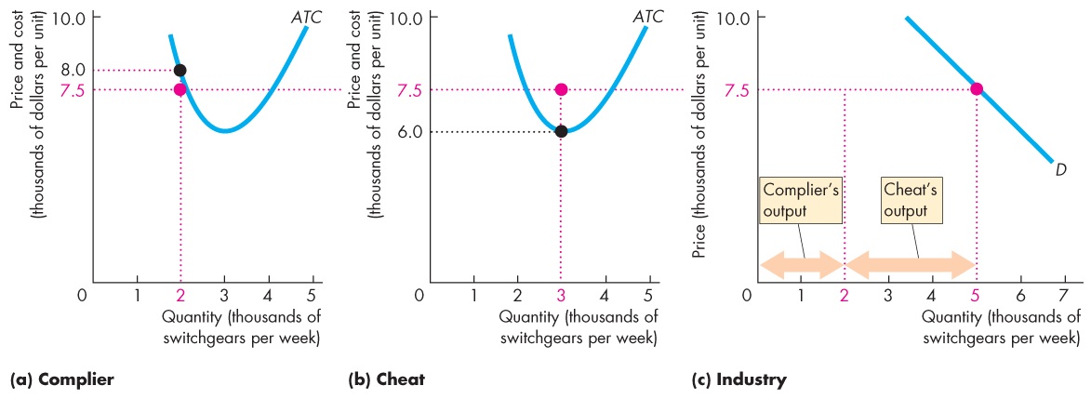
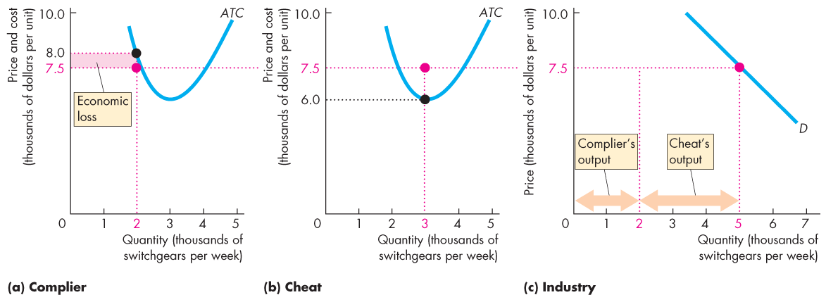
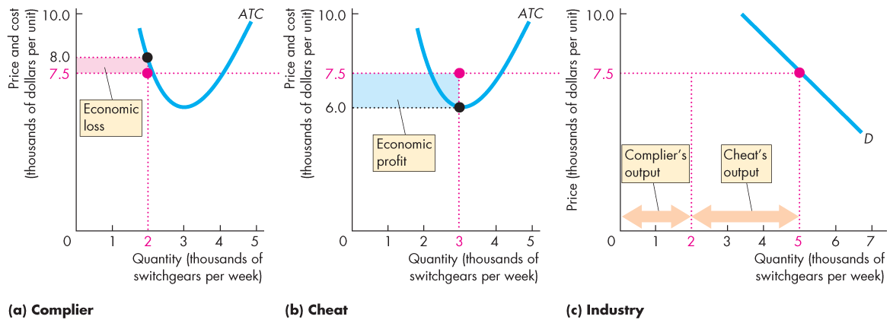

Slide 41
Oligopoly Games
For the complier, ATC now exceeds the price.
For the cheat, the price exceeds ATC.

Slide 42
Oligopoly Games
The complier incurs an economic loss.
The cheat increases its economic profit.

Slide 43
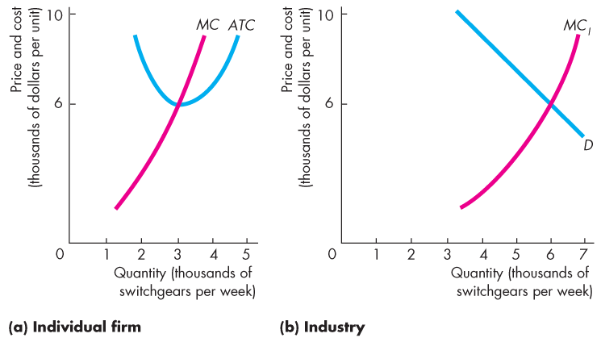
Oligopoly Games
Both Firms Cheat
Suppose that both increase their output to 3,000 units.

Slide 44
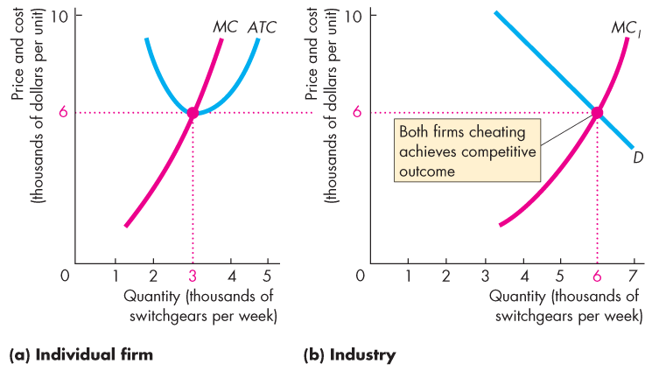

Slide 45
Oligopoly Games
Industry output is 6,000 units, the price falls.
Both firms make zero economic profit—the same as in perfect competition.

Slide 46
Oligopoly Games
The Payoff Matrix
If both comply, each firm makes $2 million a week.
If both cheat, each firm makes zero economic profit.
If Trick complies and Gear cheats, Trick incurs a loss of $1 million and Gear makes a profit of $4.5 million.
If Gear complies and Trick cheats, Gear incurs a loss of $1 million and Trick makes a profit of $4.5 million.

Slide 47
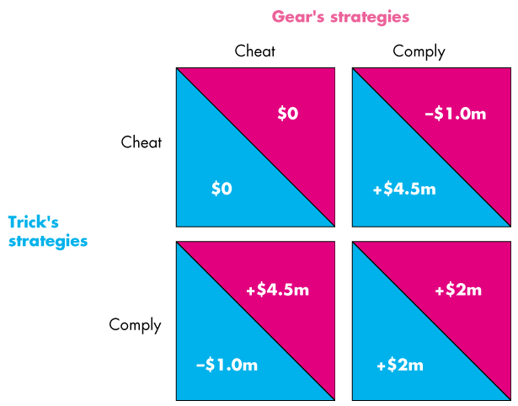
Oligopoly Games
Payoff Matrix

Slide 48
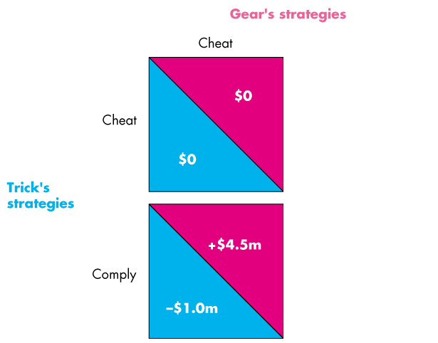
Oligopoly Games
Trick’s view of the world

Slide 49

Oligopoly Games
Trick’s view of the world

Slide 50
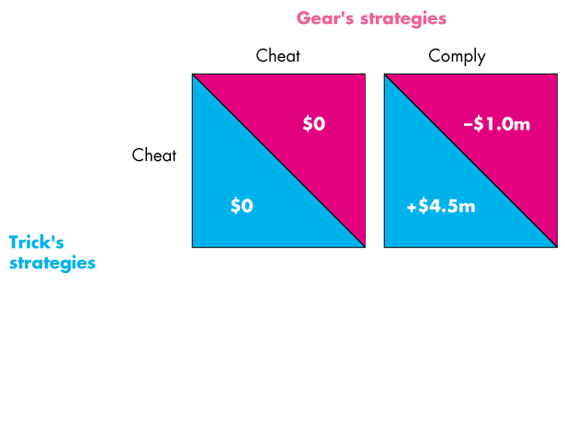
Oligopoly Games
Gear’s view of the world

Slide 51
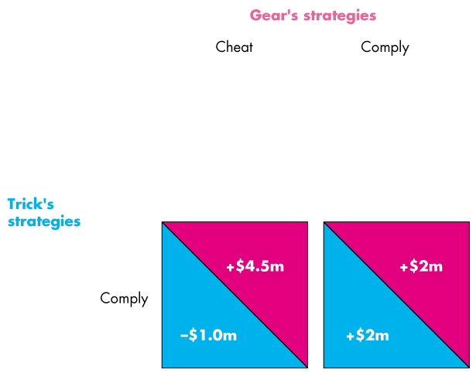
Oligopoly Games
Gear’s view of the world

Slide 52
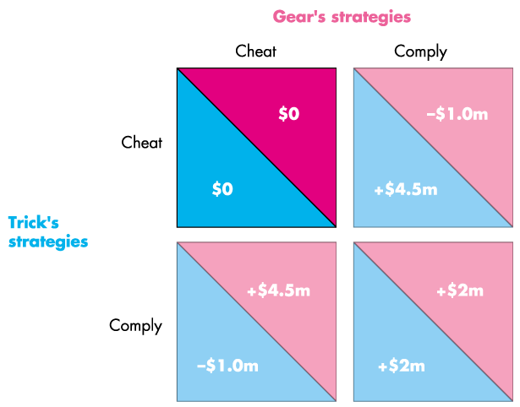
Oligopoly Games
Equilibrium

Slide 53
Oligopoly Games
Nash Equilibrium in the Duopolists’ Dilemma
The Nash equilibrium is that both firms cheat.
The quantity and price are those of a competitive market, and firms make zero economic profit.
Notes:
Classroom activity
Check out Economics in the News: Airbus Versus Boeing

Slide 54
Oligopoly Games
Other oligopoly games include advertising and research and development (R&D) games.
These games are also prisoners’ dilemmas.
Notes:
Classroom activity
Check out Economics in the News: Price War in Cellphone Service

Slide 55
Oligopoly Games
For example, an R&D Game in the Market for Tissues
Anti-Viral Kleenex and Puffs Plus Lotion weren’t developed because Kimberly-Clark (Kleenex) and P&G (Puffs) were thinking about helping you cope with a miserable cold.
These tissues and other innovations in the quality of facial tissues are the product of a costly R&D game.
The next slide shows the payoff matrix for the R&D game that Kimberley Clark and Puffs played.

Slide 56
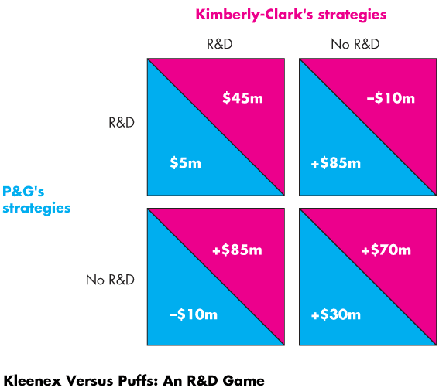
Oligopoly Games
Payoff Matrix

Slide 57
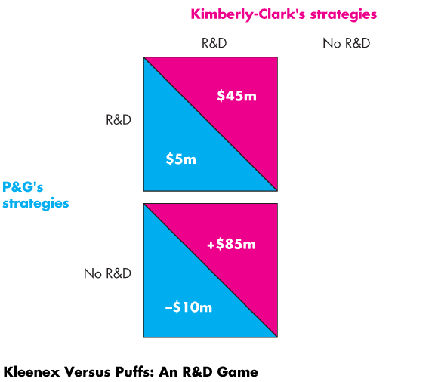
Oligopoly Games
P&G’s view of the world

Slide 58
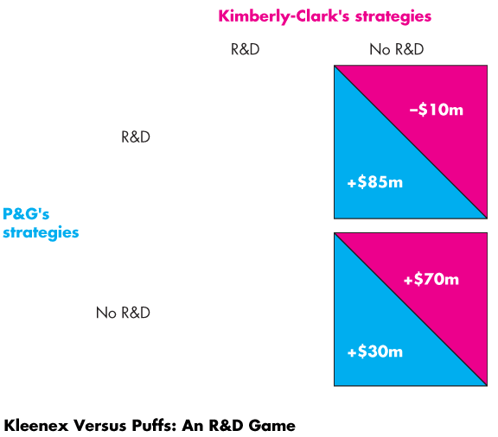
Oligopoly Games
P&G’s view of the world

Slide 59
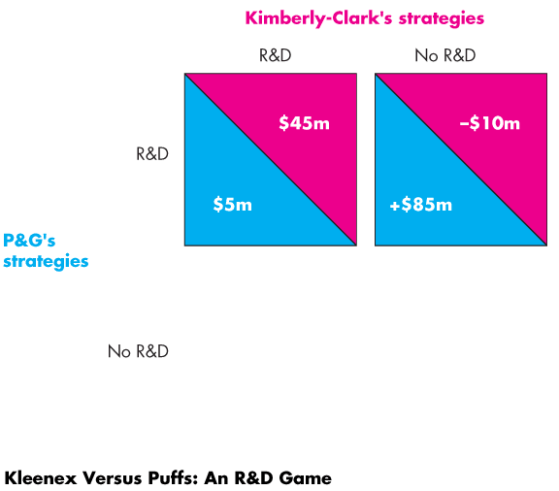
Oligopoly Games
Kimberly-Clark’s view of the world

Slide 60
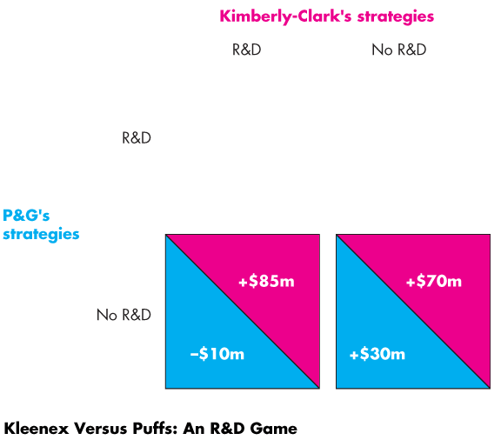
Oligopoly Games
Kimberly-Clark’s view of the world

Slide 61
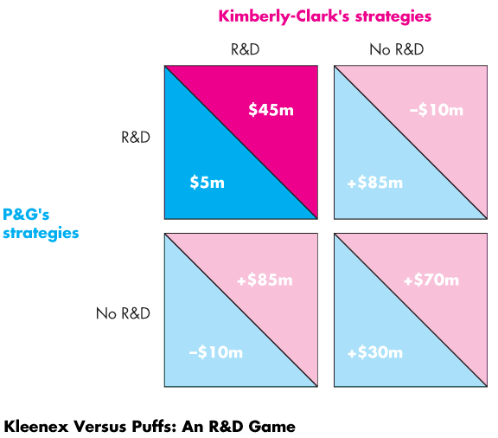
Oligopoly Games
Equilibrium of the game

Slide 62
Oligopoly Games
A Game of Chicken
An economic game of chicken can arise when R&D creates a new technology that cannot be patented.
Both firms can benefit from the R&D of either firm.
Suppose that either Apple or Nokia spends $9 million developing a new touch-screen technology that both would end up being able to use, regardless of which firm spends the $9 million.
The next slide shows the payoff matrix.

Slide 63
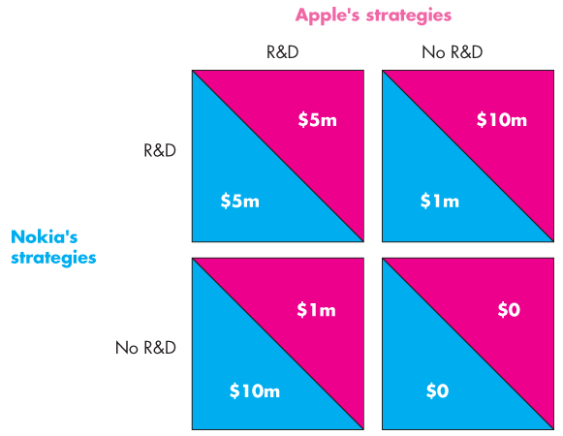
Oligopoly Games
Payoff Matrix

Slide 64
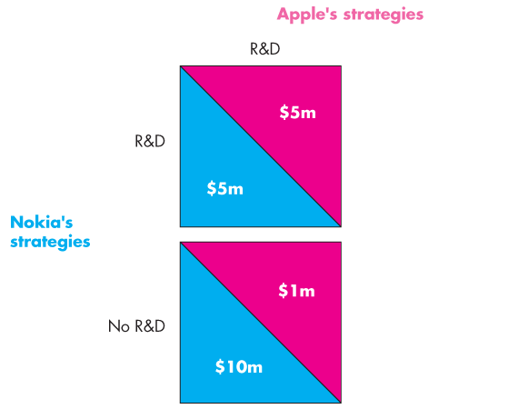
Oligopoly Games
If Apple does R&D, Nokia’s best strategy is not to do R&D.

Slide 65
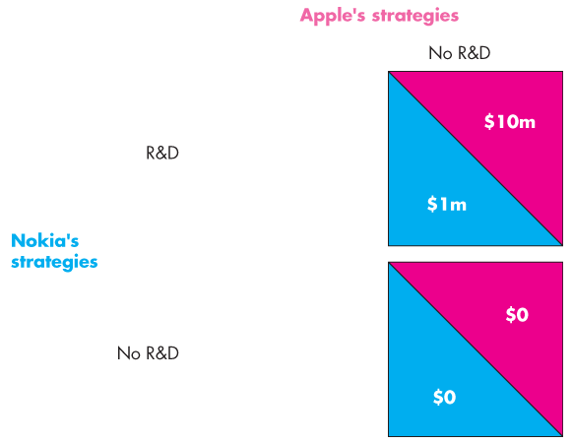
Oligopoly Games
If Apple does no R&D, Nokia’s best strategy is to do R&D.
Notes:
.

Slide 66
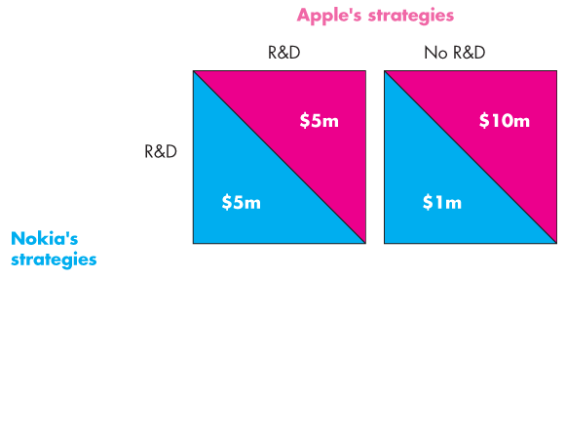
Oligopoly Games
If Nokia does R&D, Apple’s best strategy is not to do R&D.

Slide 67
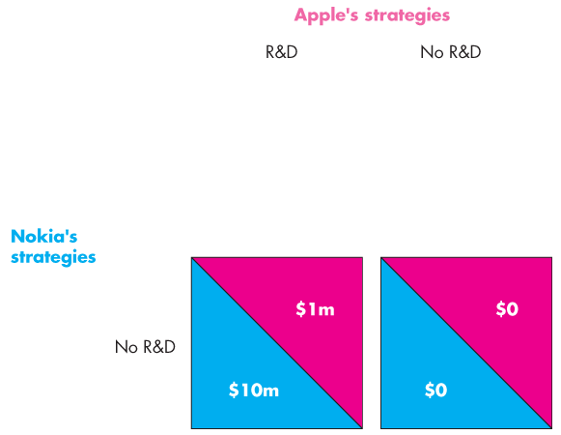
Oligopoly Games
If Nokia does no R&D, Apple’s best strategy is to do R&D.

Slide 68
Oligopoly Games
The equilibrium for this R&D game of chicken is for one firm to do the R&D.
But we cannot tell which firm will do the R&D and which will not.

Slide 69
Repeated Games and Sequential Games
A Repeated Duopoly Game
If a game is played repeatedly, it is possible for duopolists to successfully collude and make a monopoly profit.
If the players take turns and move sequentially, many outcomes are possible.
Also additional punishment strategies enable the firms to comply and achieve a cooperative equilibrium, in which the firms make and share the monopoly profit.
Notes:
The repeated prisoners’ dilemma and punishment
The interesting fact about this extension of the prisoners’ dilemma is that punishment strategies can support a cooperative equilibrium, lead to maximum (monopoly) profit, and an inefficient allocation of resources.

Slide 70
Repeated Games and Sequential Games
One possible punishment strategy is a tit-for-tat strategy.
A tit-for-tat strategy is one in which one player cooperates this period if the other player cooperated in the previous period but cheats in the current period if the other player cheated in the previous period.
A more severe punishment strategy is a trigger strategy.
A trigger strategy is one in which a player cooperates if the other player cooperates but plays the Nash equilibrium strategy forever thereafter if the other player cheats.

Slide 71
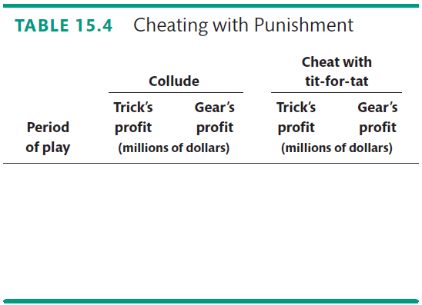
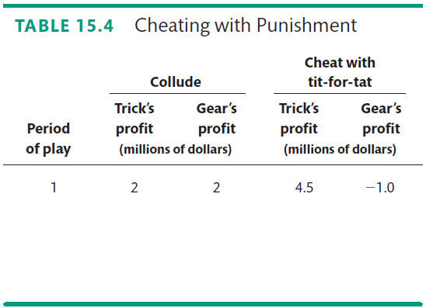

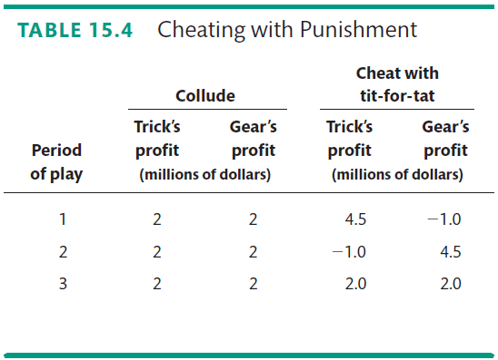
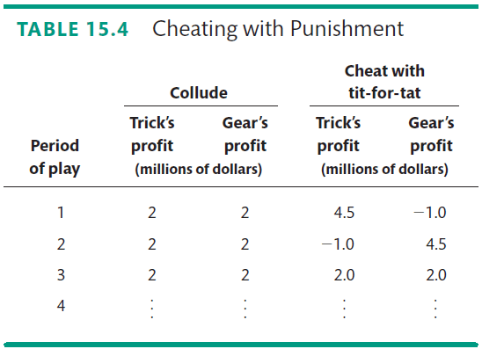
Repeated Games and Sequential Games
Table 15.4 shows that a tit-for-tat strategy is sufficient to produce a cooperative equilibrium in a repeated duopoly game.

Slide 72
Repeated Games and Sequential Games
Games and Price Wars
Price wars might result from a tit-for-tat strategy where there is an additional complication—uncertainty about changes in demand.
A fall in demand might lower the price and bring forth a round of tit-for-tat punishment.

Slide 73
Repeated Games and Sequential Games
A Sequential Entry Game in a Contestable Market
In a contestable market—a market in which firms can enter and leave so easily that firms in the market face competition from potential entrants—firms play a sequential entry game.
Notes:
Entry game
The textbook uses the simplest possible example to illustrate the sequential entry game in a contestable market. It doesn’t explicitly explain the backward induction method of solving such a game, but it implicitly uses that method. You might want to be explicit.

Slide 74
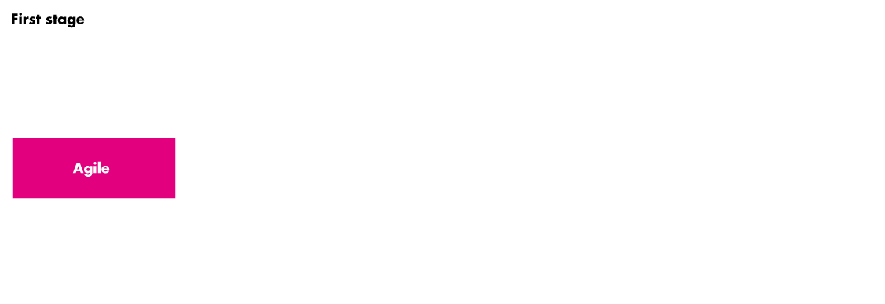
Repeated Games and Sequential Games
Figure 15.6 shows the game tree for a sequential entry game in a contestable market.

Slide 75
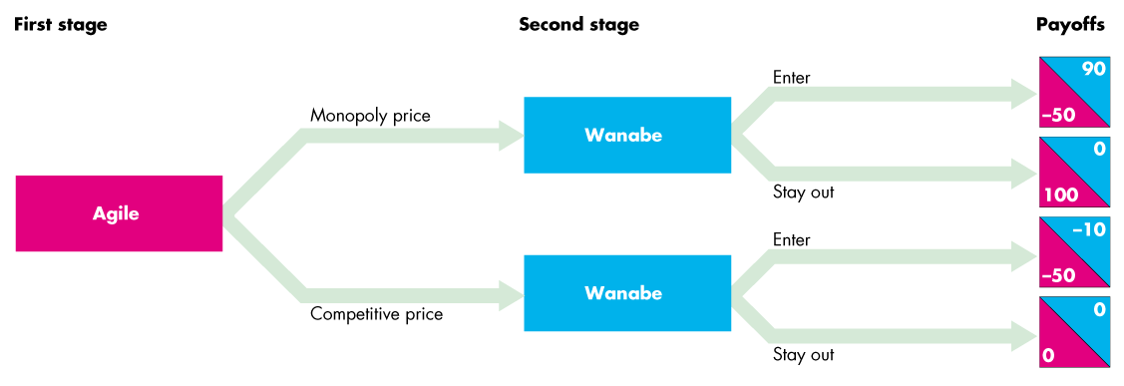


Slide 76
Repeated Games and Sequential Games
In the first stage, Agile decides whether to set the monopoly price or the competitive price.

Slide 77
Repeated Games and Sequential Games
In the second stage, Wanabe decides whether to enter or stay out.
Wannabe’s payoffs are in blue and Agile’s are in red.

Slide 78
Repeated Games and Sequential Games
The equilibrium is Agile sets a competitive price and makes zero economic profit to keep Wanabe out.

Slide 79
Repeated Games and Sequential Games
A less costly strategy is limit pricing, which sets the price at the highest level that is consistent with keeping the potential entrant out.

Slide 80
Antitrust Law
Antitrust law provides an alternative way in which the government may influence the marketplace.
Antitrust law is the law that regulates oligopolies and prevents them from becoming monopolies or behaving like monopolies.
The Antitrust Laws
The two main antitrust laws are
The Sherman Act, 1890
The Clayton Act, 1914
Notes:
Emphasize the tension between combining formerly separate goods into a product as a monopolizing action (tying agreements) and combining goods as a form of technological advancement to enhance consumer surplus (product innovation).
The Microsoft defense to antitrust charges alludes to the inevitable combining of web browsers into computer operating system software. Microsoft could be truly enhancing its product but it also could be using its market power in one market to capture market power in another, more competitive market.

Slide 81

Antitrust Law
The Sherman Act outlawed any “combination, trust, or conspiracy that restricts interstate trade,” and prohibited the “attempt to monopolize.”

Slide 82
Antitrust Law
A wave of merger activities at the beginning of the 20th century produced a stronger antitrust law, the Clayton Act, and created the Federal Trade Commission.
The Clayton Act
The Clayton Act made illegal specific business practices such as price discrimination, interlocking directorships, and acquisition of a competitor’s shares if the practices “substantially lessen competition or create monopoly.”

Slide 83
Antitrust Law
Table 15.6 (next slide) summarizes the Clayton Act and its amendments, the Robinson-Patman Act passed in 1936 and the Cellar-Kefauver Act passed in 1950.
The Federal Trade Commission, formed in 1914, looks for cases of “unfair methods of competition and unfair or deceptive business practices.”

Slide 84

Antitrust Law

Slide 85
Antitrust Law
Price Fixing Always Illegal
Price fixing is always a violation of the antitrust law.
If the Justice Department can prove the existence of price fixing, there is no defense.

Slide 86
Antitrust Law
Three Antitrust Policy Debates
But some practices are more controversial and generate debate. Three of them are
Resale price maintenance
Tying arrangements
Predatory pricing
Notes:
Classroom activity
Check out Economics in Action: The United States Versus Microsoft

Slide 87
Antitrust Law
Resale Price Maintenance
Most manufacturers sell their product to the final consumer through a wholesale and retail distribution chain.
Resale price maintenance occurs when a manufacturer agrees with a distributor on the price at which the product will be resold.
Resale price maintenance is inefficient if it promotes monopoly pricing.
But resale price maintenance can be efficient if it provides retailers with an incentive to provide an efficient level of retail service in selling a product.

Slide 88
Antitrust Law
Tying Arrangements
A tying arrangement is an agreement to sell one product only if the buyer agrees to buy another different product as well.
Some people argue that by tying, a firm can make a larger profit.
Where buyers have a differing willingness to pay for the separate items, a firm can price discriminate and take a larger amount of the consumer surplus by tying.
Notes:
You might want to talk about Windows and the Explorer Browser at this point as an example.

Slide 89
Antitrust Law
Predatory Pricing
Predatory pricing is setting a low price to drive competitors out of business with the intention of then setting the monopoly price.
Economists are skeptical that predatory pricing actually occurs.
A high, certain, and immediate loss is a poor exchange for a temporary, uncertain, and future gain.
No case of predatory pricing has been definitively found.
Notes:
You might like to talk about John D. Rockefeller’s Standard Oil and the accusation that it engaged in this practice back in the 1890s. See http://www.history.com/topics/john-d-rockefeller for a useful source of material for a classroom discussion of this topic.

Slide 90
Antitrust Law
Mergers and Acquisitions
The Federal Trade Commission (FTC) uses guidelines to determine which mergers to examine and possibly block.
The Herfindahl-Hirschman index (HHI) is one of those guidelines (explained in Chapter 9).
If the original HHI is between 1,500 and 2,500, any merger that raises the HHI by 100 or more is challenged.
If the original HHI is greater than 2,500, any merger that raises the HHI by 200 is generally blocked.
Notes:
Classroom activity
Check out Economics in Action: No Cellphone Service Merger

